Slide 1

Artificial Intelligence
Lecture 3 (part11)
By/ aly maher abdelfattah

Slide 2
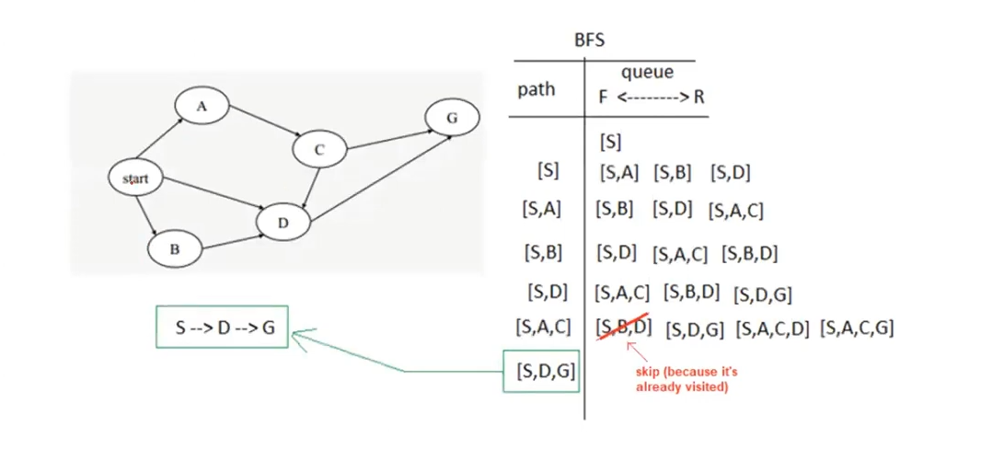
Breadth first search (BFS)

Slide 3
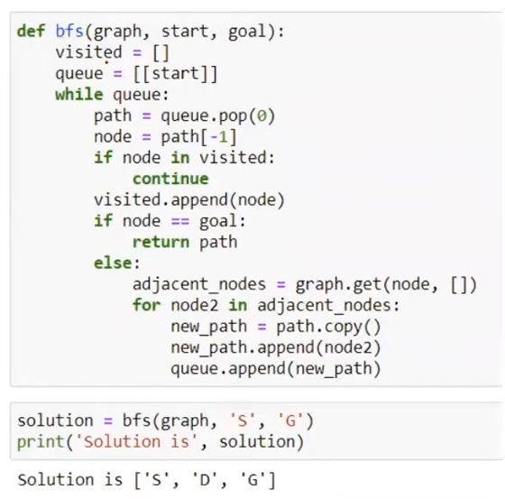
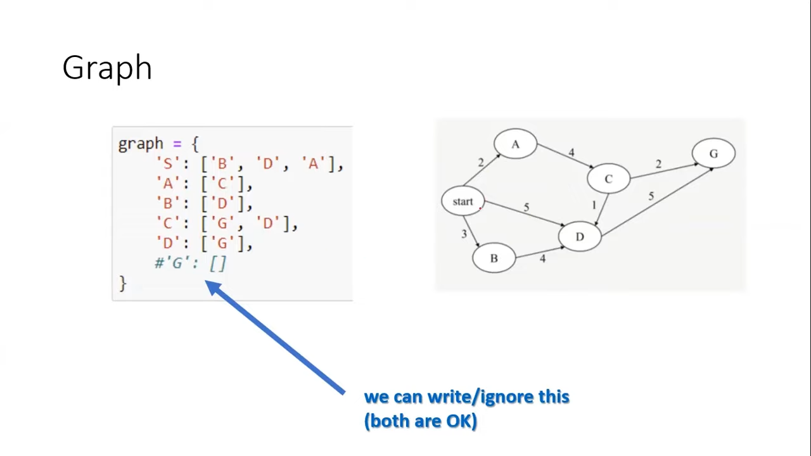
Breadth first search (BFS) => code

Slide 4
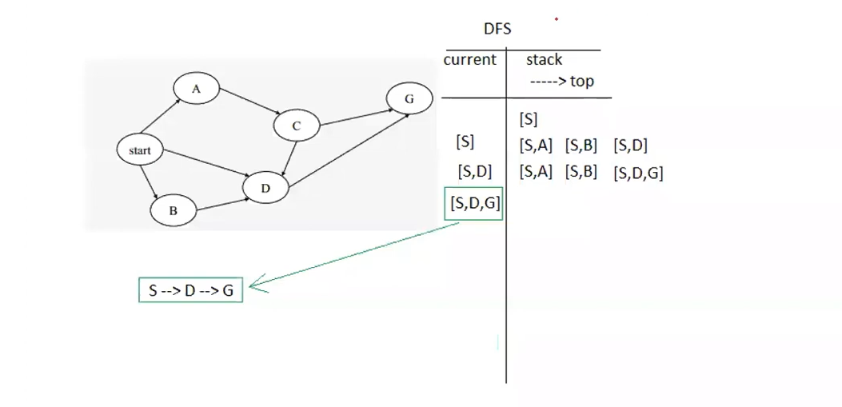
Depth first search (DFS)

Slide 5
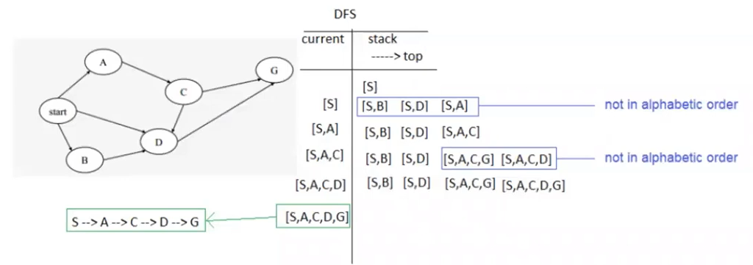
Depth first search (DFS)
Note : if you don’t flow alphabetic order, you may get a different answer
Your answer will still be correct (but different)
However, in order to get a unified answer, it’s recommended that you follow alphabetic order

Slide 6
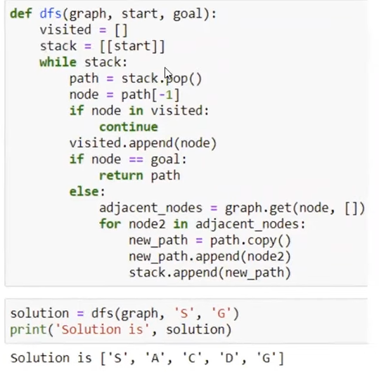
Depth first search (DFS) => code

Slide 7
Depth-First vs. Breadth-First
Depth-first goes off into one branch until it reaches a leaf node
- Not good if the goal is on another branch
- Uses much less space than breadth-first
Breadth-first is more careful by checking all alternatives
- Very memory-intensive
- For a large tree, breadth-first search memory requirements maybe excessive
- For a large tree, a depth-first search may take an excessively long time to find even a very nearby goal node.

Slide 8

Thank you

